Slide 1

TARGET FOLDER
SRNTGT030
Olenogorsk West Air Defense Academy, SRN
SECRET - DCS WORLD
REL TO COALITION
SECRET - DCS WORLD
REL TO COALITION

Slide 2

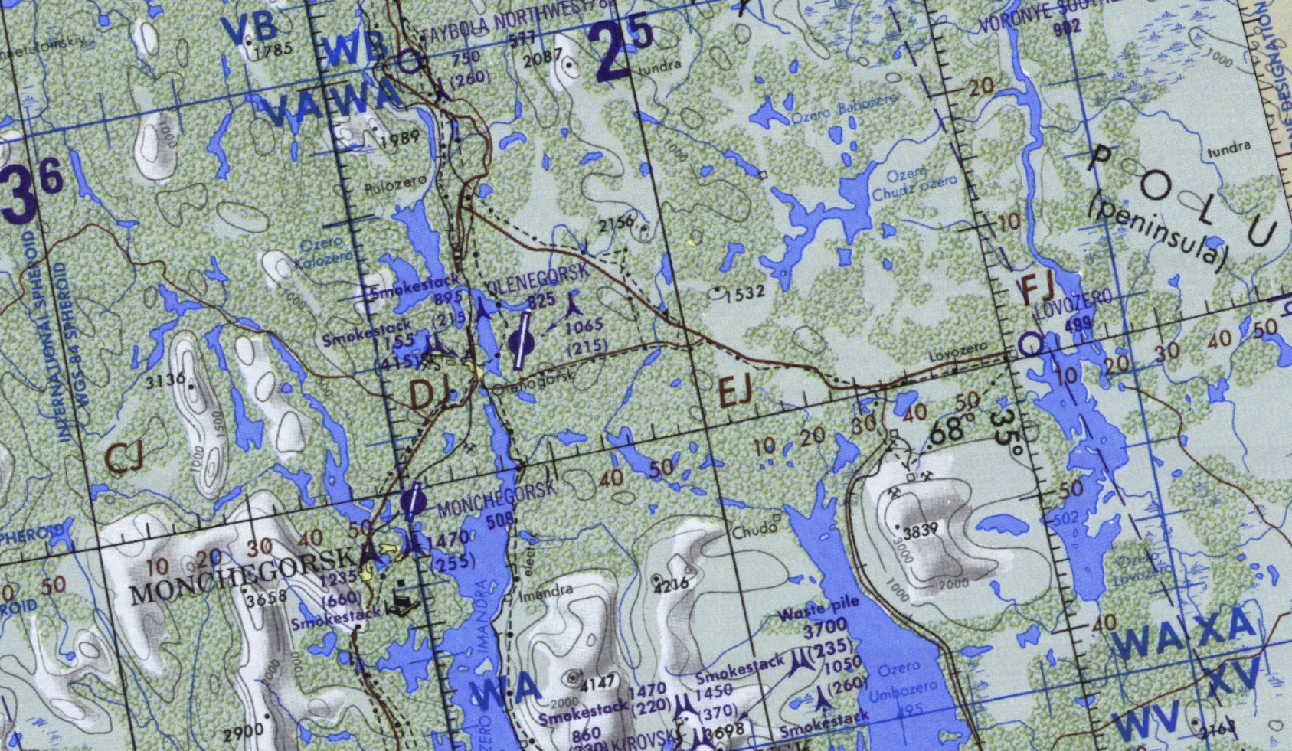
Olenogorsk West Air Defense Academy, SRN
OPAC CLASSIFIED REL TO CJTF-23
JOINT OPERATIONS GRAPHIC 1
MAP
OVERVIEW
BE: SRNTGT030 CATCODE: 5
MIDB GEO: N 68 06.475 E 033 55.806
ICOD: 2011-JUL-09 DOI:2011-JUL-09
DECL ON: 2061-JUL-09
N
Olenogorsk West Air Defense Academy SRNTGT030
.

Slide 3
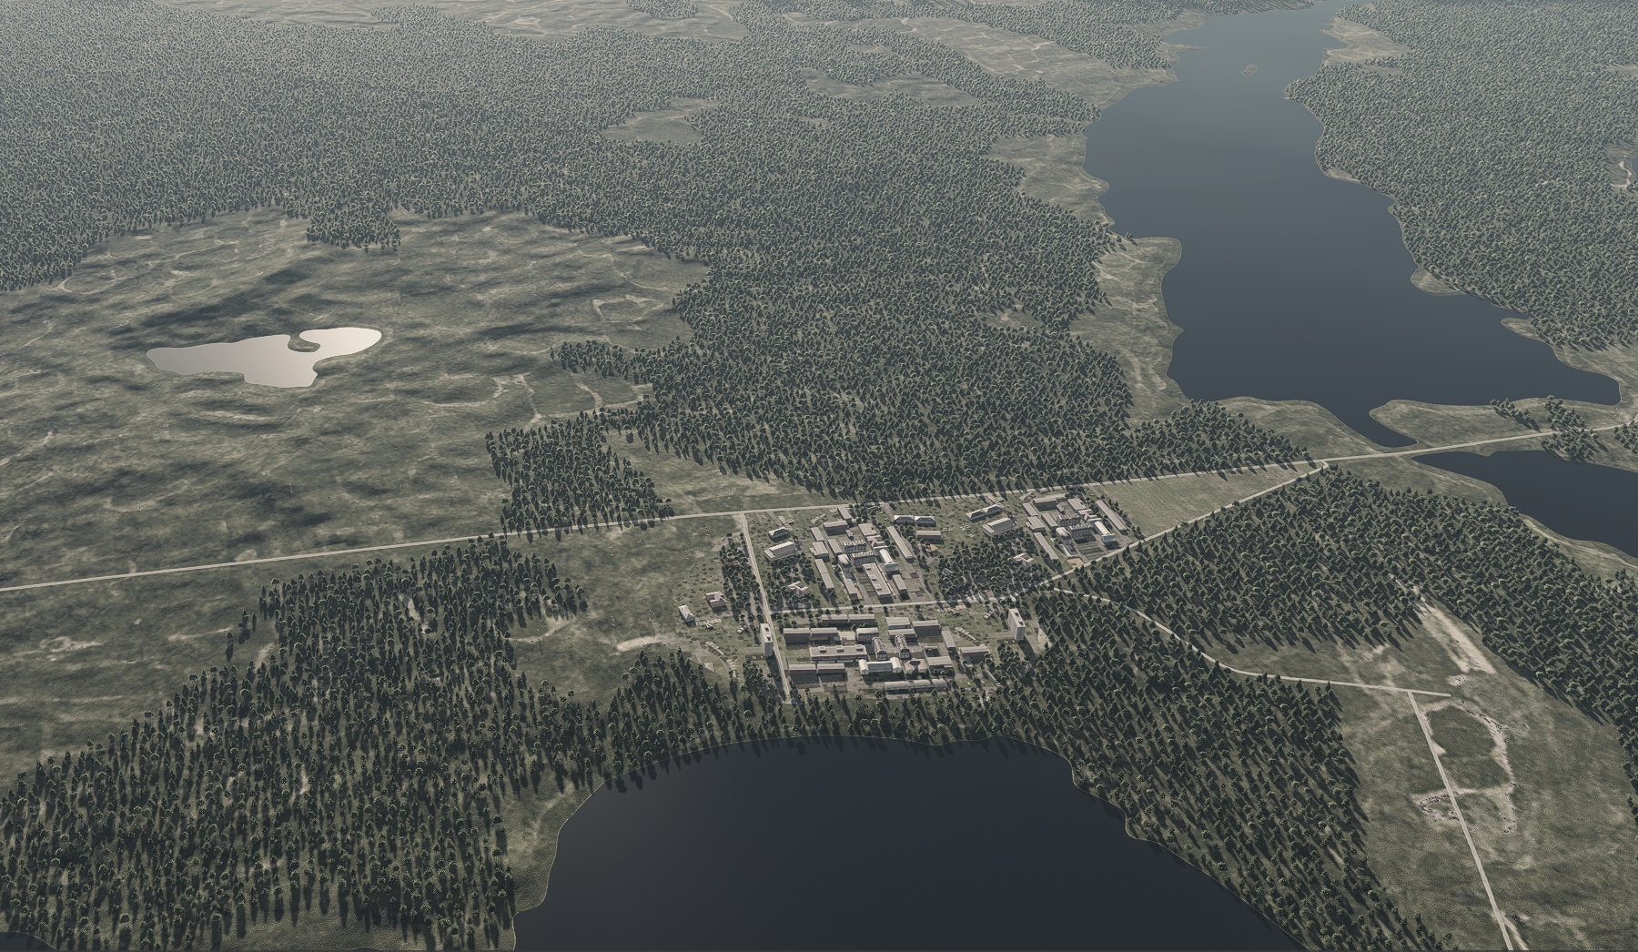
Olenogorsk West Air Defense Academy, SRN
OPAC CLASSIFIED REL TO CJTF-23
FACILITY OUTLINE GRAPHIC 1/1
MAP
OVERVIEW
BE: SRNTGT030 CATCODE: 5
MIDB GEO: N 68 06.475 E 033 55.806
ICOD: 2011-JUL-09 DOI:2011-JUL-09
DECL ON: 2061-JUL-09
N
Olenogorsk West Air Defense Academy SRNTGT025

Slide 4
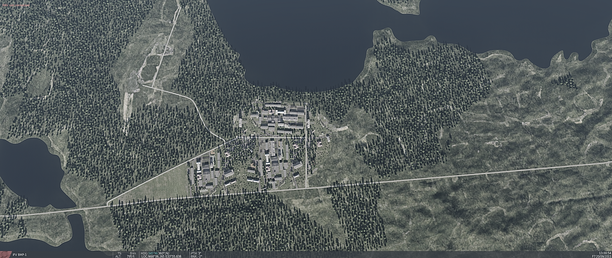
Olenogorsk West Air Defense Academy, SRN
OPAC CLASSIFIED REL TO CJTF-23
DESIRED POINT OF IMPACT GRAPHIC 1/1
MAP
OVERVIEW
BE: SRNTGT030 CATCODE: 5
MIDB GEO: N 68 06.475 E 033 55.806
ICOD: 2011-JUL-09 DOI:2011-JUL-09
DECL ON: 2061-JUL-09
N
DPI: 2
DPI: 1
DPI: SRNTGT030-1 SCHOOL BUILDING 1
N 68 06.380 E 033 55.900
DPI MSL: 770 FT
DPI: SRNTGT030-2 SCHOOL BUILDING 2
N 68 06.536 E 033 55.655
DPI MSL: 770 FT

Slide 5
Olenogorsk West Air Defense Academy, SRN
OPAC CLASSIFIED REL TO CJTF-23
WEAPONEERING OPTIONS 1/1
MAP
OVERVIEW
BE: SRNTGT030 CATCODE: 5
MIDB GEO: N 68 06.475 E 033 55.806
ICOD: 2011-JUL-09 DOI:2011-JUL-09
DECL ON: 2061-JUL-09
DPI | DESCRIPTION | TLE | WARHEAD | GUIDANCE | DESIRED EFFECT | IMPACT ANGLE | FUZING
DPI 1 | MULTISTORY HORSE SHOE BUILDING | 3 | 1000IBS | DECIMETERIC | BLAST | 60˚ - 90˚ | 25ms
DPI 2 | MULTISTORY HORSE SHOE BUILDING | 3 | 1000IBS | DECIMETERIC | BLAST | 60˚ - 90˚ | 25ms

Slide 6
Olenogorsk West Air Defense Academy, SRN
OPAC CLASSIFIED REL TO CJTF-23
COLLATERAL DAMAGE ESTIMATION GRAPHIC 1/1
MAP
OVERVIEW
BE: SRNTGT030 CATCODE: 5
MIDB GEO: N 68 06.475 E 033 55.806
ICOD: 2011-JUL-09 DOI:2011-JUL-09
DECL ON: 2061-JUL-09
CER 812FT / 250M
N
N
DPI: 2
NCC: GAS STORAGE 30m from DPI-1
NCC: GAS STORAGE 100m from DPI-2
DPI: 1
CDE5

Slide 7
Olenogorsk West Air Defense Academy, SRN
OPAC CLASSIFIED REL TO CJTF-23
COLLATERAL DAMAGES ESTIMATION 1/1
MAP
OVERVIEW
BE: SRNTGT030 CATCODE: 5
MIDB GEO: N 68 06.475 E 033 55.806
ICOD: 2011-JUL-09 DOI:2011-JUL-09
DECL ON: 2061-JUL-09
COLLATERAL DAMAGES WITHIN A 500M RADIUS
DESCRIPTION |  | CATCODE | MIDB GEOS | LOCATION | REMARKS
CIVILIAN INFRASTRUCTURE |  | 14 |  | 100M from Any DPI | Potential Civilian Casualties
GAS STORAGE |  | 13 |  | 30M from DPI 1 | Potential secondary explosions
NO STRIKE ENTITIES WITHIN A 500M RADIUS
NSE ID | DESCRIPTION | CATCODE | MIDB GEOS | LOCATION | REMARKS
 | N/A

Slide 8
Olenogorsk West Air Defense Academy, SRN
OPAC CLASSIFIED REL TO CJTF-23
MAP
OVERVIEW
BE: SRNTGT030 CATCODE: 5
MIDB GEO: N 68 06.475 E 033 55.806
ICOD: 2011-JUL-09 DOI:2011-JUL-09
DECL ON: 2061-JUL-09
POST-STRIKE
PRE-STRIKE
N
TARGET OBJECTIVE
DAMAGE/CHANGE ASSESSMENT
DPI:[XXXXXX]
BDA REMARK: [CLASSIFICATION] [DISSEMINATION] Assessment: Physical Damage/change, Collateral Damage, Functional Damage/change, Munitions Effectiveness, Reattack Recommendation, Additional/Collateral Effects

Slide 9

ACRONYMS
ACRONYM | MEANING | DEFINITION
BE | Basic Encyclopedia Number | Alpha/numeric code unique to an installation for incorporation within various national and tactical systems.
CATCODE | Category Code | The data Element that classifies the function and purpose of an installation or a facility.
MIDB | Modernized Integrated Database | A database comprised of information on facilities of military significance, military forces, and related equipment.
ICOD | Intelligence Cut Off Date | The date of the latest intelligence data inputted to a feature.
DOI | Date of Image | Date on which a geospatial or intelligence-related image was captured.
CE | Critical Element | An element of an entity or object that enables it to perform its primary function.
PV CHAR | Physical Vulnerability Characteristic | Standardized alphanumeric code describing the physical and structural properties of a target.
DPI | Joint Desired Point of Impact | A unique, alphanumeric coded aimpoint identified by a three dimensional mensurated point. It represents a weapon or capability desired point of impact or penetration.
CE90 | Circular Error at 90% | 90 percent confidence level in the horizontal plane.
LE90 | Linear Error at 90% | 90 percent confidence level in the vertical dimension
MSL | Mean Sea Level | Elevation above Earth reference geoid.
AGL | Above Ground Level | Elevation above ground surface.
NCC | Nearest Collateral Concern | Closest non-targeted structure, area, or entity near a planned point of impact that may be at risk of unintended damage during a military strike.
CER | Collateral effects radius | Radius within which collateral damage might happen based on the weapon's characteristics, the target environment, and other operational factors.
CDE | Collateral damage estimate | Systematic process used in military targeting to evaluate the potential for unintended damage or harm to non-combatant entities, structures, or personnel as a result of a planned strike.
NSE | No Strike Element | Specific entities, locations, or objects that are protected from intentional targeting under the Law of Armed Conflict (LOAC) or by operational policy.

